Slide 1

An EL Project on
Online Exam Management System
Submitted to Manipal University, Jaipur
Towards the partial fulfilment for the Award of the Degree of
BACHELORS OF TECHNOLOGY
In Computer and Communication Engineering
2020-2021
By
Akshat Verma
199303205
Priyam Thakkar
199303169
Akshat Sharma
199303187

Slide 2
About the Project:
This project is helpful for students to take examination online by giving them the examination link automatically plus the other exam details.
This project has been developed using MySQL command line client, PHP and HTML/CSS. The required Database is "online_exam" and has five tables that are ‘Student’, ‘Subject’, ‘Exam’, 'Teacher' and 'Administrator'. These are the five entities in this Database.
We can:
Append new entries to all three tables
Delete the existing entries.
Update the entries
Generate link for the exam on one click.
To all the tables in the Database. We have created a menu-driven program to easily manage, add, alter and delete the data entries in the tables. On executing the code, it will automatically connect to the database on the Local Host server. As the execution of the program continues the program will provide the user with various options to manipulate and edit the various tables in the Database.

Slide 3

Methodology
Administrator has all the rights to make changes in all other tables, by default database has details of two admins.
Login page has three views: student, teacher, administrator.
Student can login using his/her login details to view information related to exams but cannot make any changes.
Teacher can login similarly to create, update or delete exam.
Administrator can login to add, delete, update or view details of student, teacher, exam and subject.

Slide 4
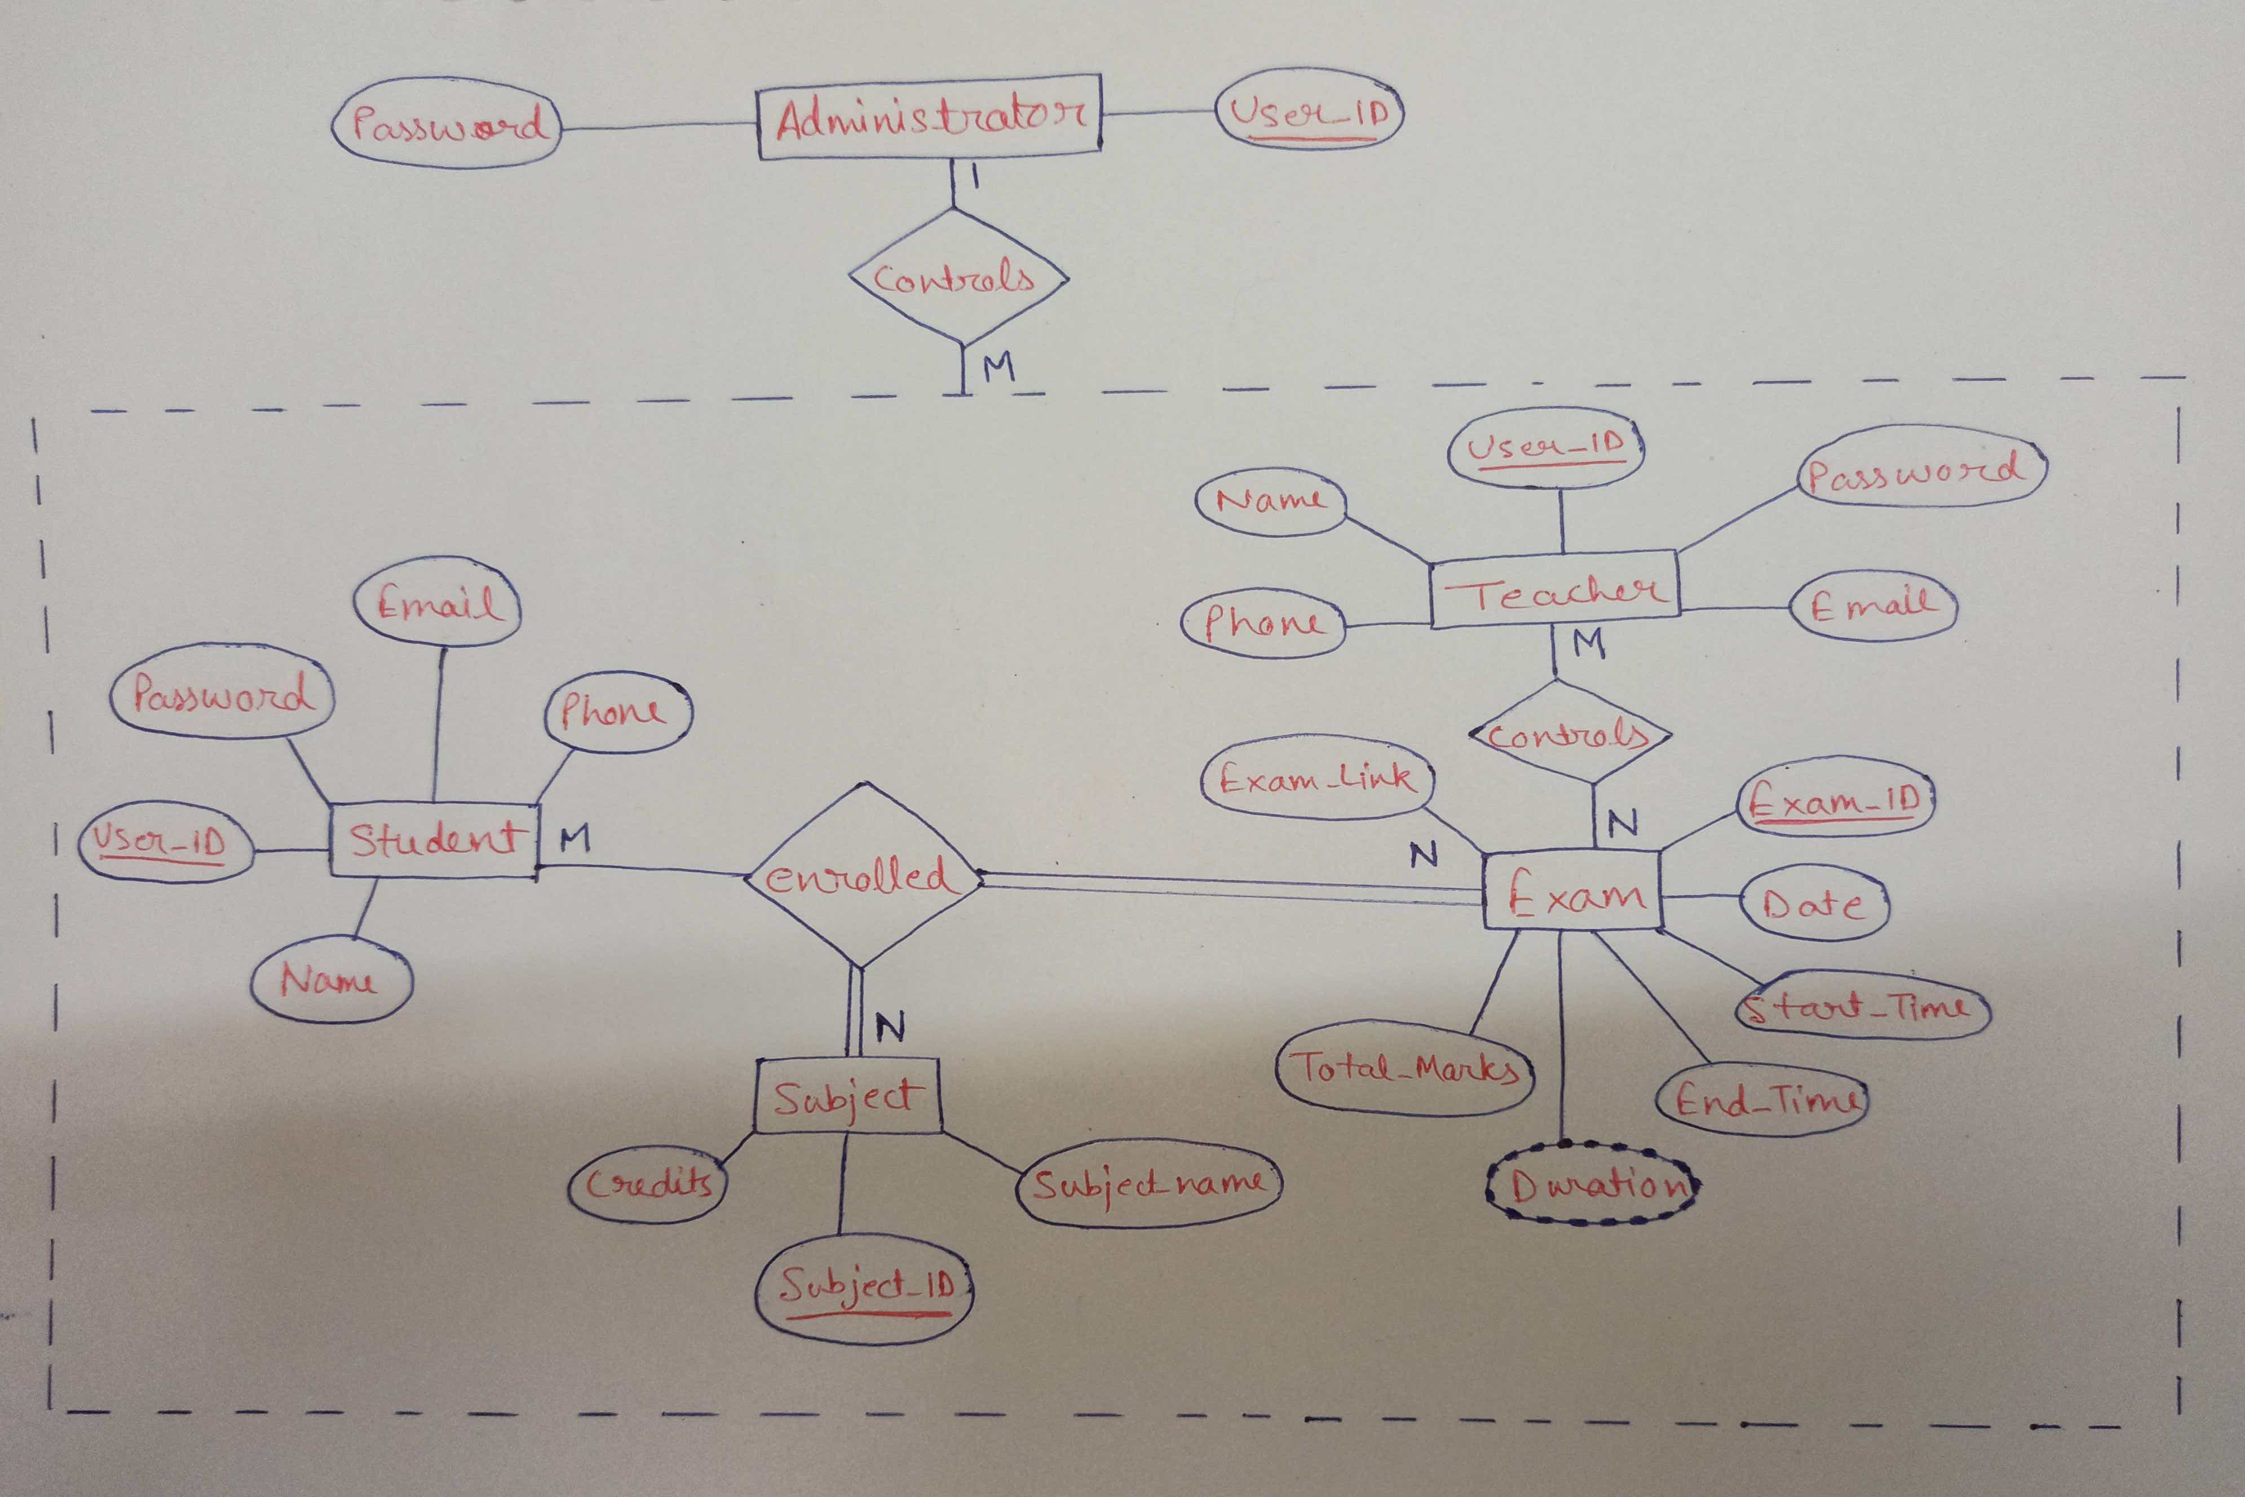
ER MODEL

Slide 5

Look into the database

Slide 6
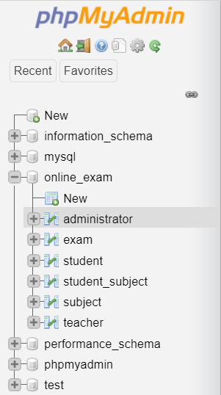

Slide 7
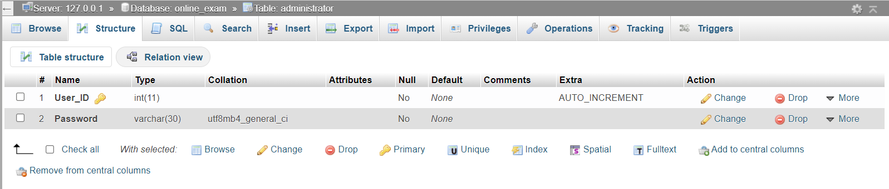
DESCRIPTION OF TABLES
Administrator Table

Slide 8
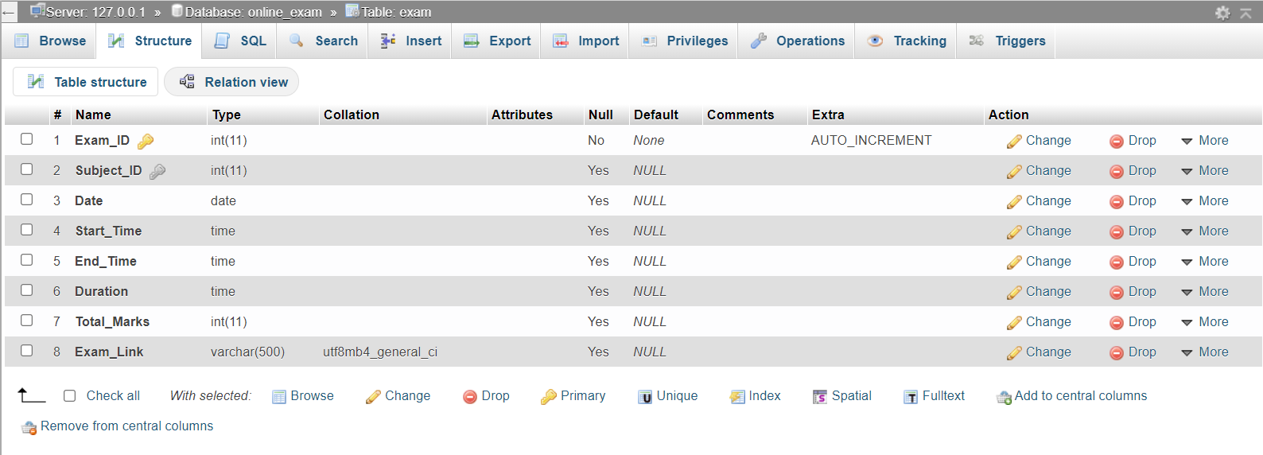
Exam Table

Slide 9
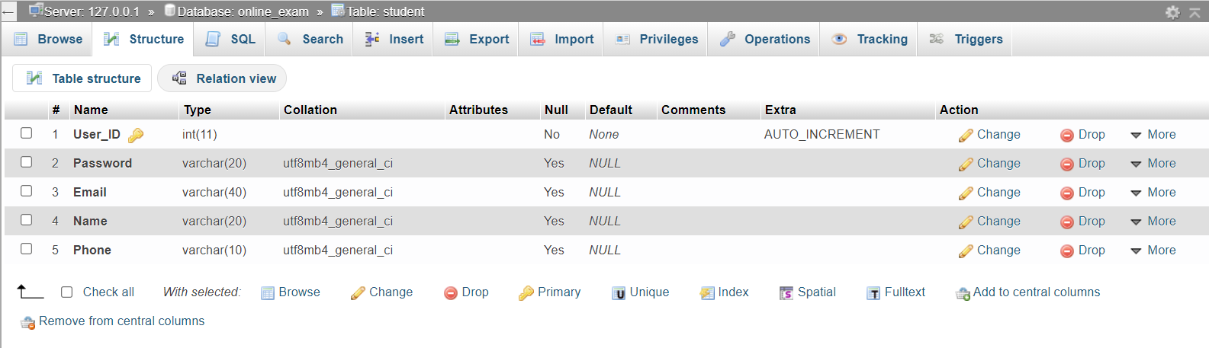
Student Table

Slide 10
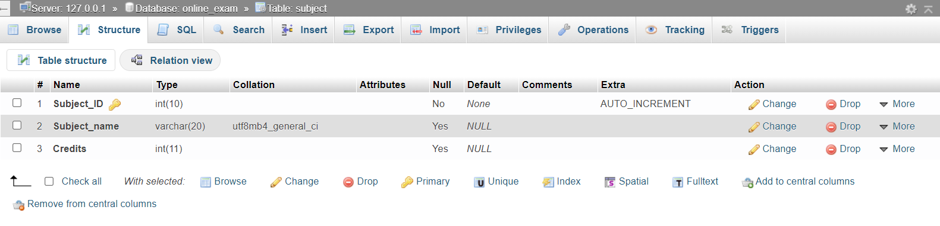
Subject Table

Slide 11
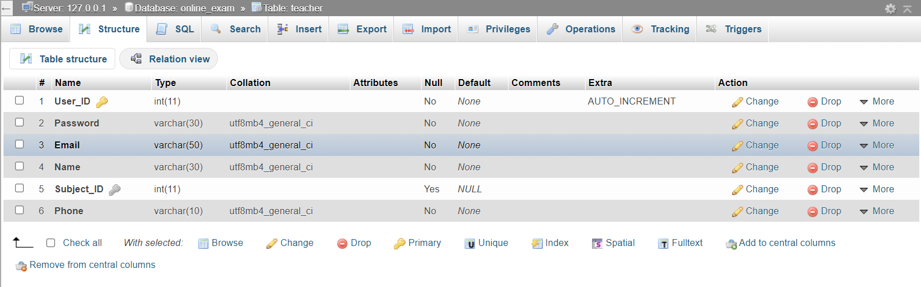
Teacher Table

Slide 12
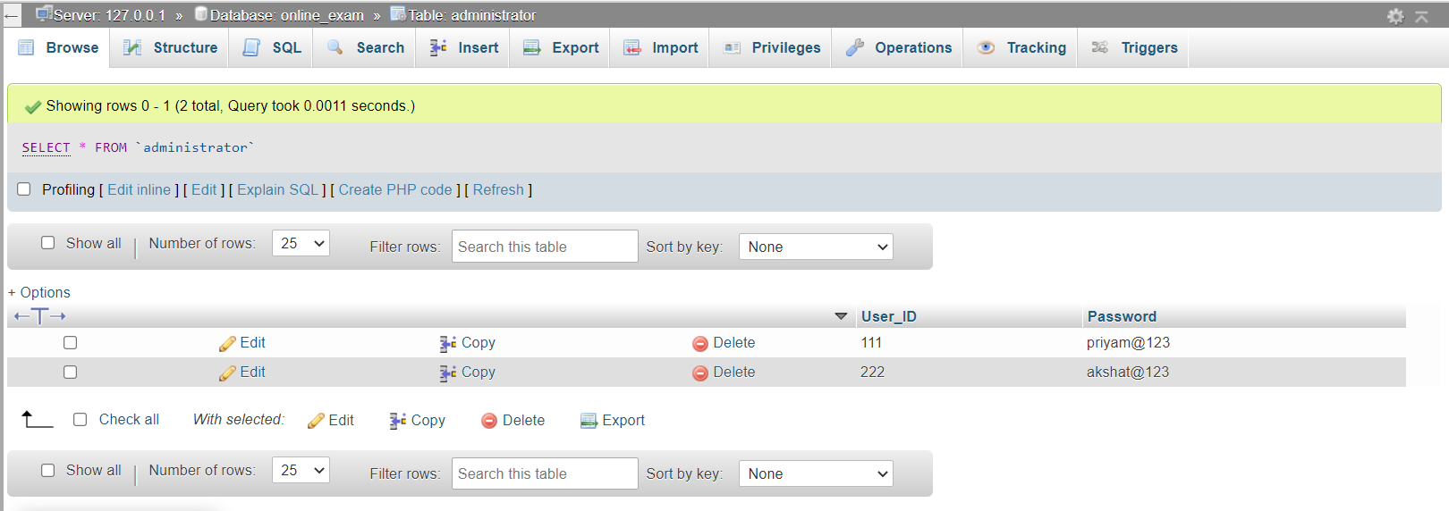
DATA USED
Administrator Table

Slide 13
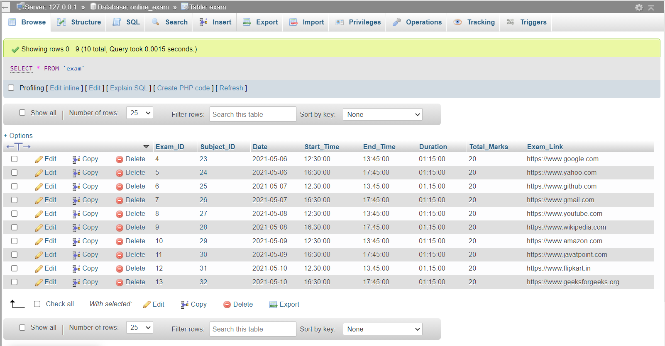
Exam Table

Slide 14
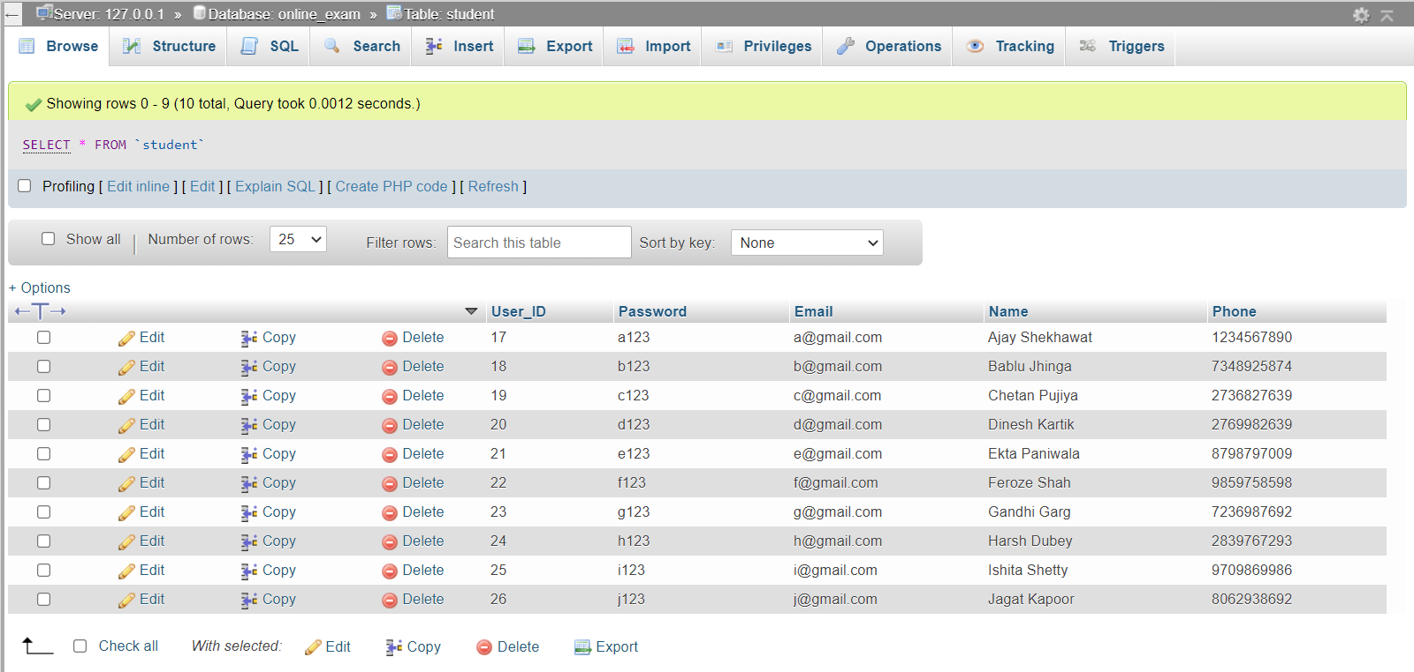
Student Table

Slide 15
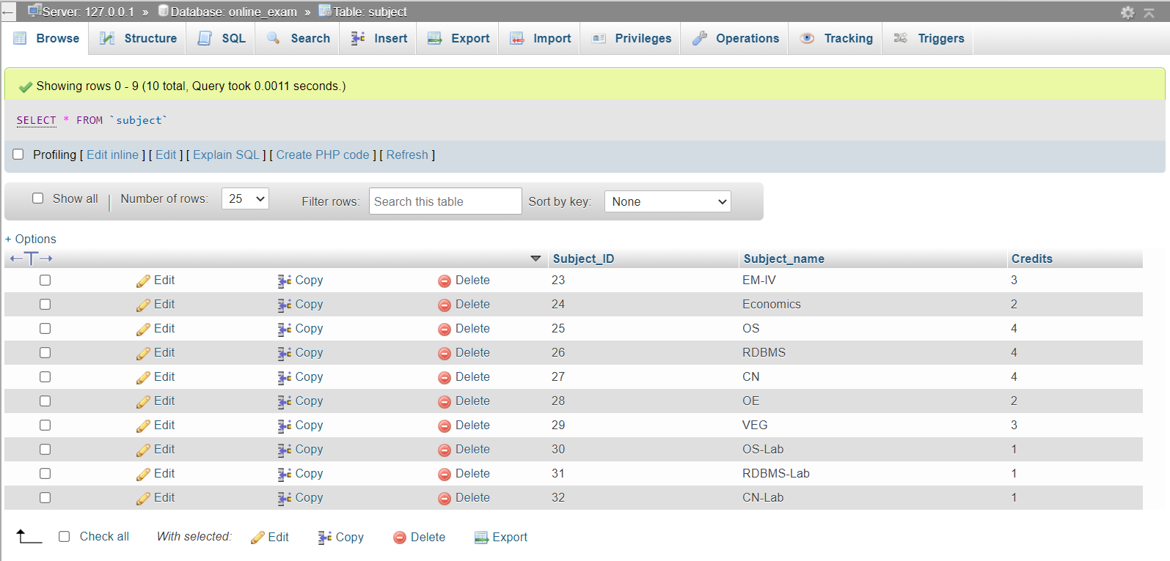
Subject Table

Slide 16
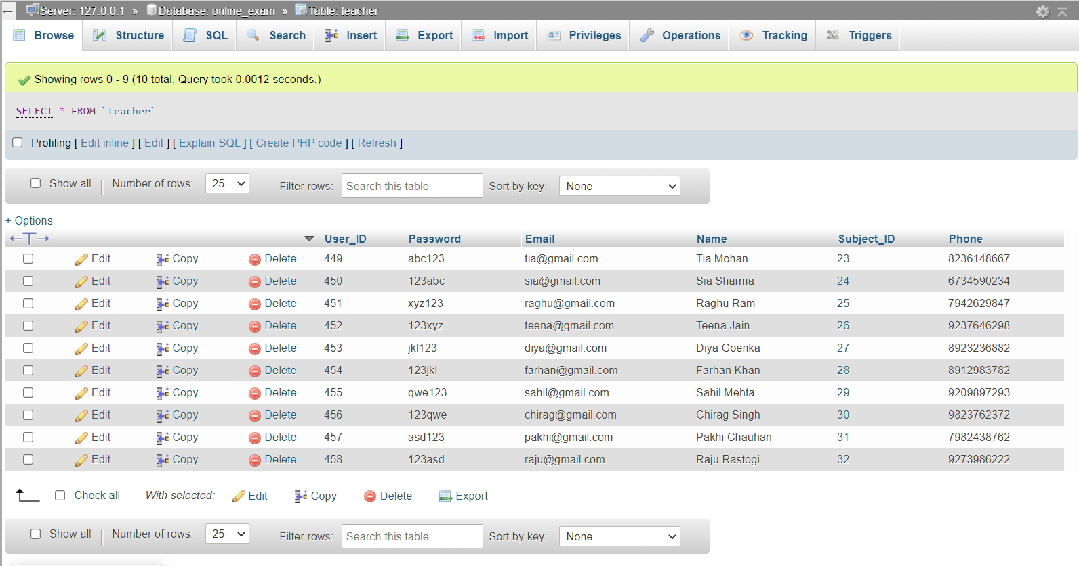
Teacher Table

Slide 17

LOOK INTO FRONT END

Slide 18
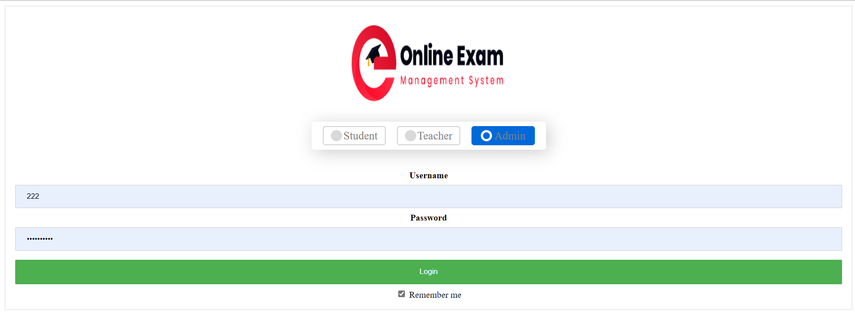
Login Page

Slide 19
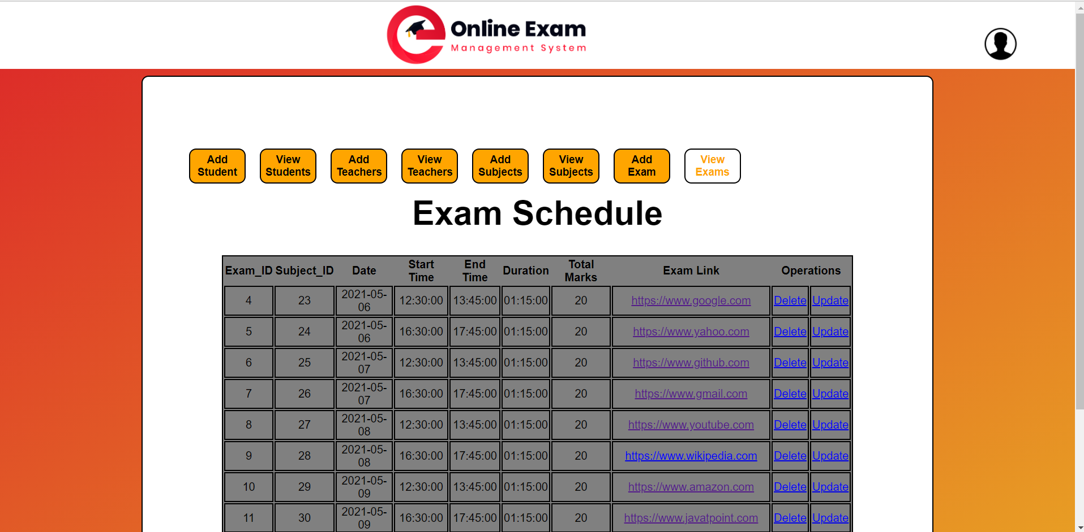
ADMIN VIEW PAGE

Slide 20
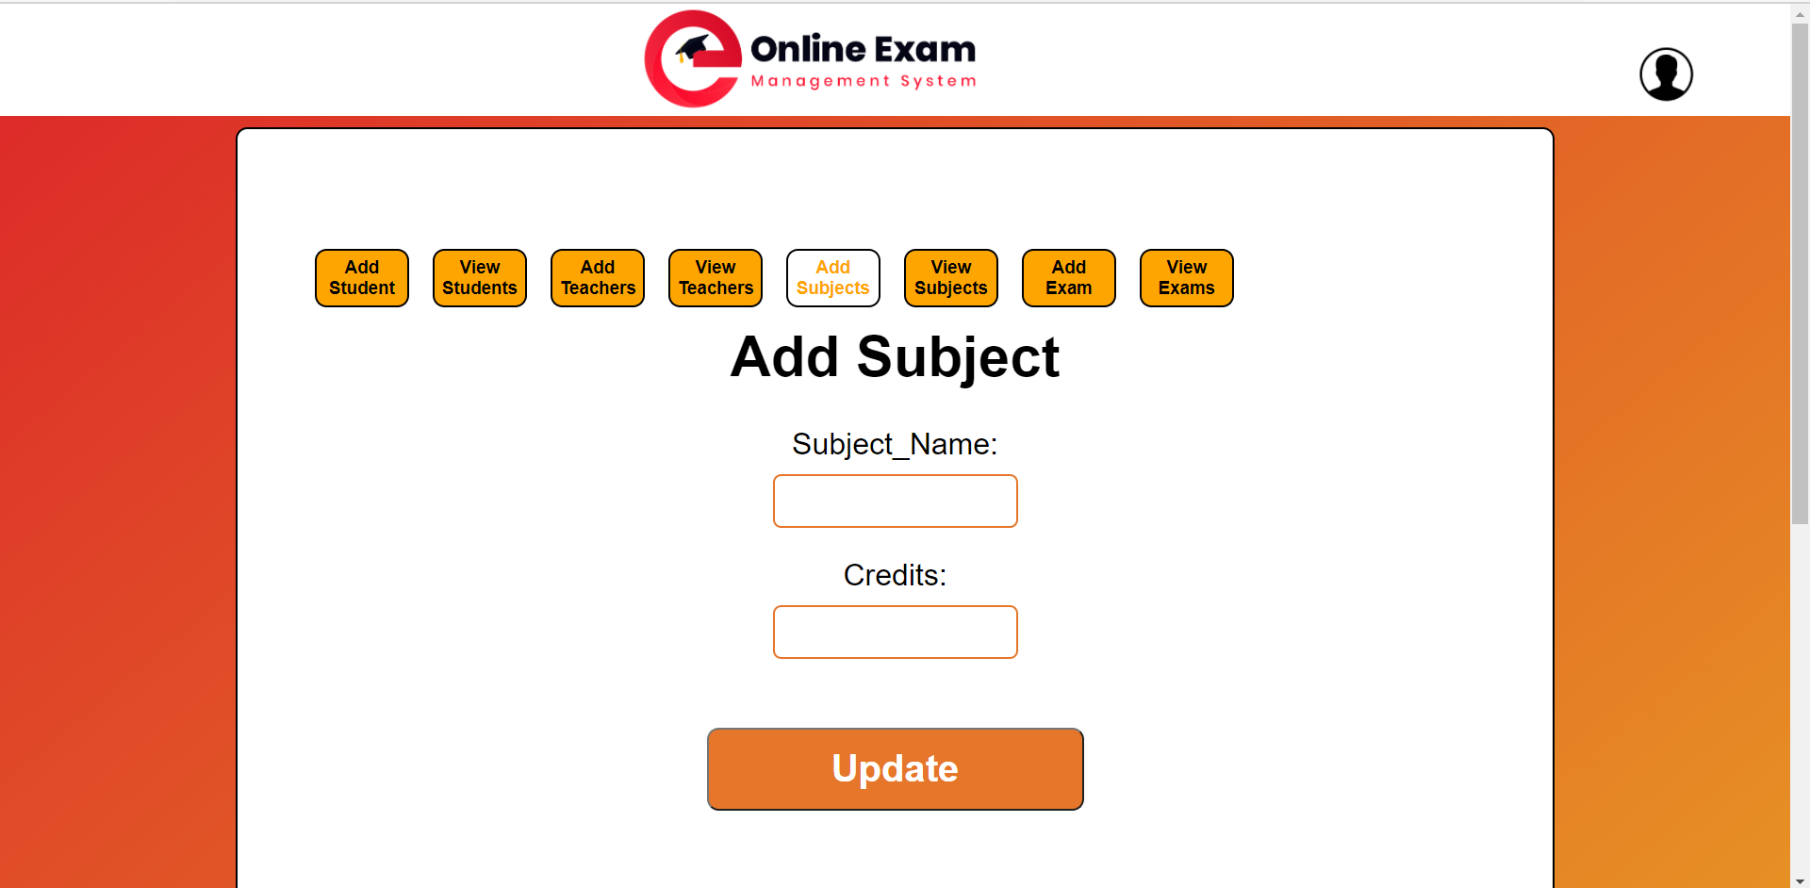
ADMIN EDIT PAGE

Slide 21
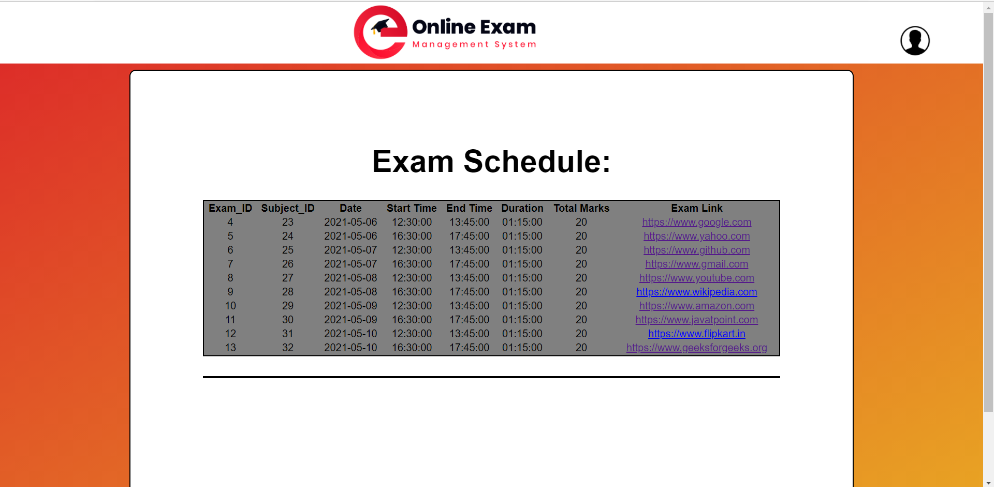
Student View Page

Slide 22
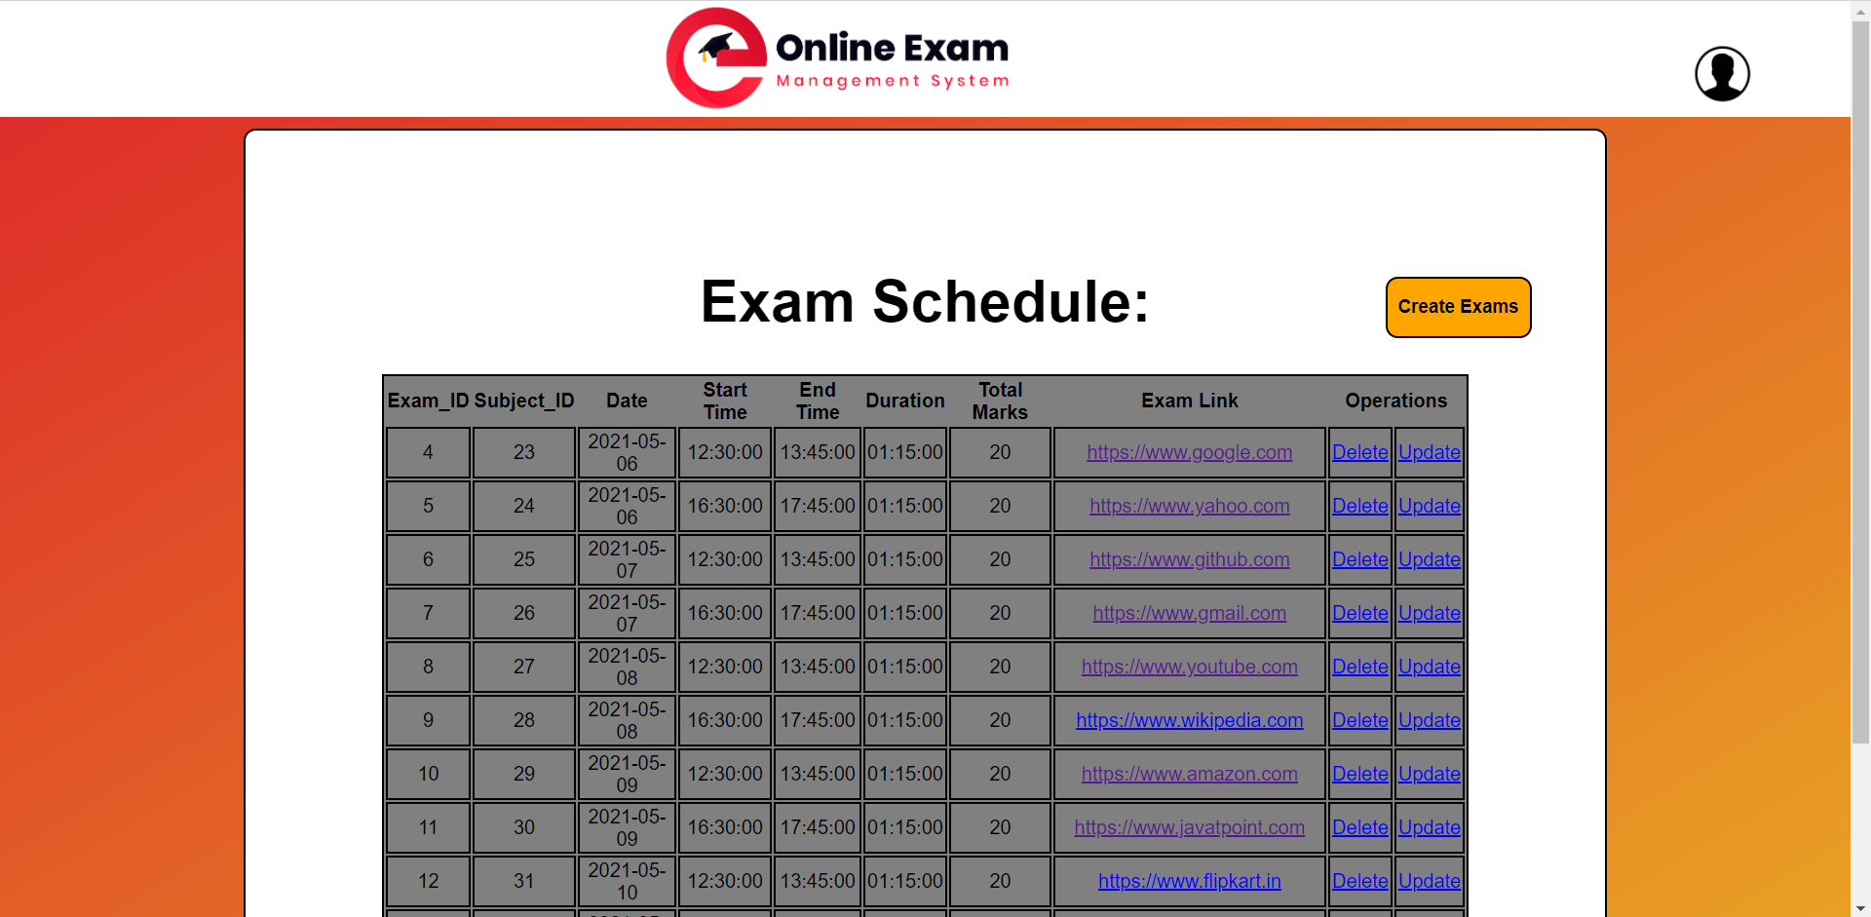
Teacher Exam View Page

Slide 23
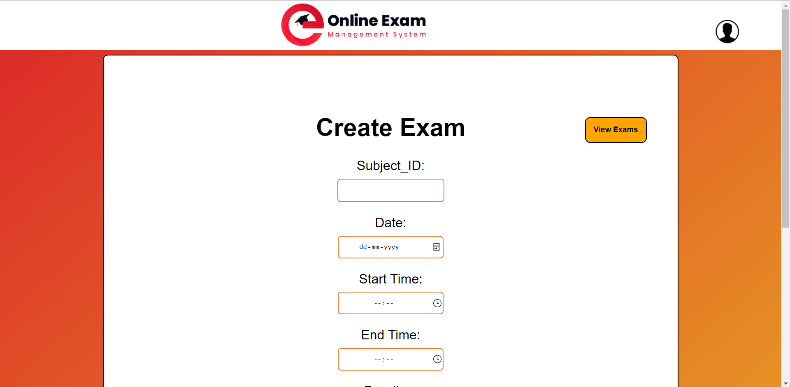
Teacher Create Exam Page

Slide 24
Conclusion
In a situation like pandemic where the educational institutes have drifted towards the online format to continue educating young minds while keeping them safe, project like these are the key to make that happen. Hence, there is no doubt that in current scenario, this project has a good market potential. Competitive advantage is that students who do not have the application and are dependent on the others for the class link can get it easily through the user interface we create.

Slide 25


